Slide 1


Slide 2

Introduction to Shader development
h_da WS2020/21
Paul Nasdalack
info@paul-nasdalack.com
@littleBugHunter

Slide 3








About myself

Slide 4
About myself
Some things we might be able to cover

Slide 5
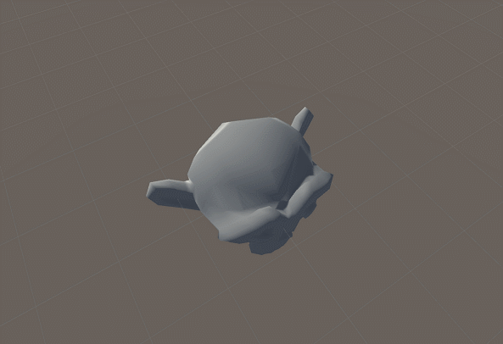

Slide 6
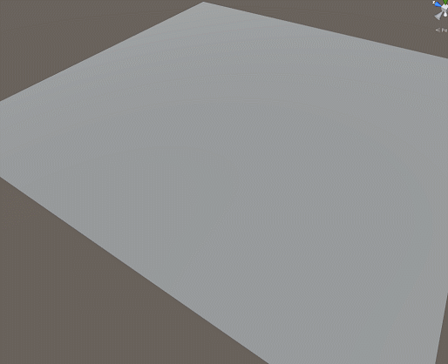

Slide 7
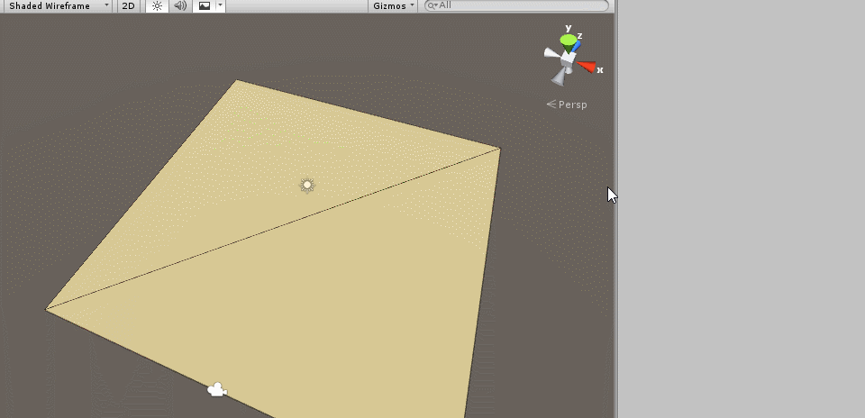

Slide 8
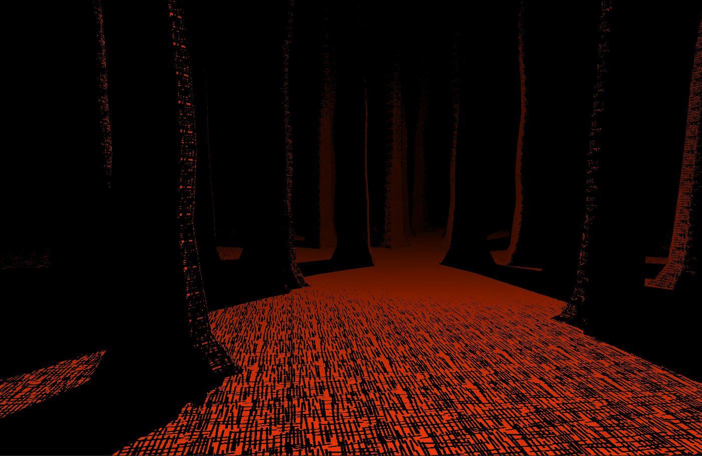

Slide 9
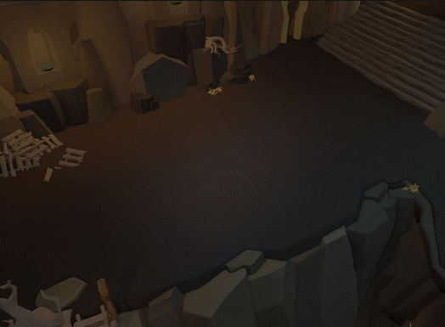

Slide 11
About this course
Introduction to Graphics Pipeline and Shaders
General fx tips and tricks
Prototyping techniques
We will be writing code!
I’m counting on your input!

Slide 12
About this course
Recap
Presentation
Prototyping in ShaderGraph
Technical implementation in Code
Creative Shader Building

Slide 13
Possible Takeaways for you
Create your own shaders and effects
Have a better understanding of the GPU
Be able to optimize your own assets

Slide 14
Possible Takeaways for your team
You’ll have a better understanding of other departments
You’ll be able to handle your own shit
You won’t cause Performance drops
You’ll make the game BEAUTIFUL!!!!!!! *O*

Slide 15
What do you need
Some knowledge about 3D development
A computer/laptop during the lecture
School math
Vectors
Matrices
We will do a quick recap on both
Do an assignment at the end of the course

Slide 16
What about you?
Why did you choose to attend this course?
Do you have any experience with shaders and or coding?
What do you expect from this course?

Slide 17
Structure
Introduction (we just did this)
What is a GPU and why do we need it
How does 3d hardware work
How does a shader work

Slide 18
What is a GPU and why do we need it? aka: a brief history of graphics hardware
DISCLAIMER!!!!
This is not a history lesson
A lot of things will be very simplified

Slide 19

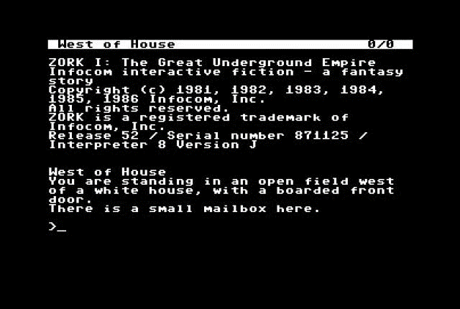
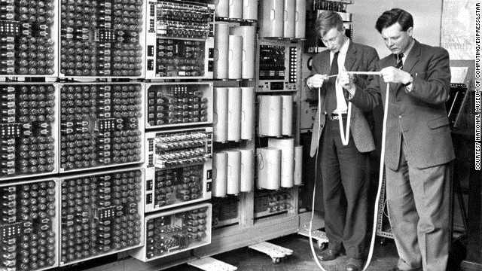
What is a GPU and why do we need it? aka: a brief history of graphics hardware
In the beginning there was the CPU

Slide 20
What is a GPU and why do we need it? aka: a brief history of graphics hardware
Only text support
We want direct pixel access!!!!!
320x240px = 76800 pixels 60 times a second
(or 50 times, if you live in Europe)
That’s 4,608,000 pixels per second!
CPUs back then could only do 1,000,000-2,000,000 operations per second
FUCK!

Slide 21
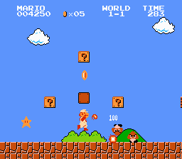
What is a GPU and why do we need it? aka: a brief history of graphics hardware
Wait a minute the NES had more than text!

Slide 22
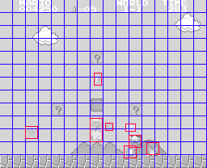
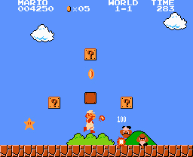
What is a GPU and why do we need it? aka: a brief history of graphics hardware
BEHOLD THE PPU!!!!
CPU
PPU

Slide 23
What is a GPU and why do we need it? aka: a brief history of graphics hardware
PPU is specifically designed to render pixels
It is fixed to always render a background and a bunch of sprites
Can’t do anything else!
CPU prepares all the “level data” and sprite positions, the PPU just talks to the screen

Slide 24
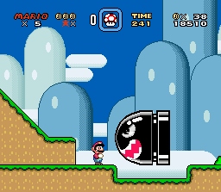
What is a GPU and why do we need it? aka: a brief history of graphics hardware
BEHOLD THE SNES!
MORE PIXELS!!!!
MORE COLORS!!!!
BIGGER SPRITES!!!!

Slide 25
What is a GPU and why do we need it? aka: a brief history of graphics hardware
BEHOLD THE SNES!
BUT MOST IMPORTANTLY…

Slide 26
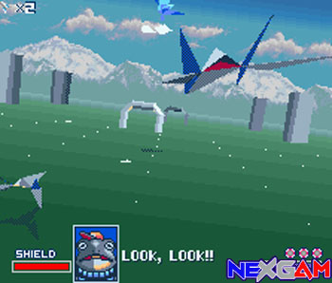
What is a GPU and why do we need it? aka: a brief history of graphics hardware
BEHOLD THE SNES!
3D!!!!!

Slide 27
What is a GPU and why do we need it? aka: a brief history of graphics hardware
SuperFX Chip
Separate (faster) CPU on the game cartridge
Very fast at multiplications
Could render arbitrary Bitmaps (not tile data)

Slide 28
What is a GPU and why do we need it? aka: a brief history of graphics hardware
Having a separate CPU on the cartridge sucks
You have to put one on each game, you sell
Let‘s build it into the console/computer (the GPU was born)

Slide 29
Well… Actually

Slide 30
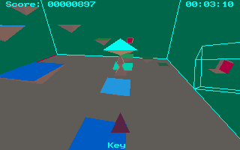
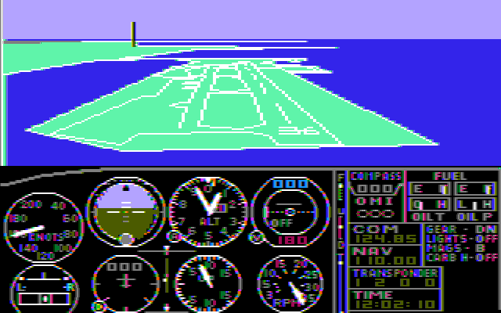
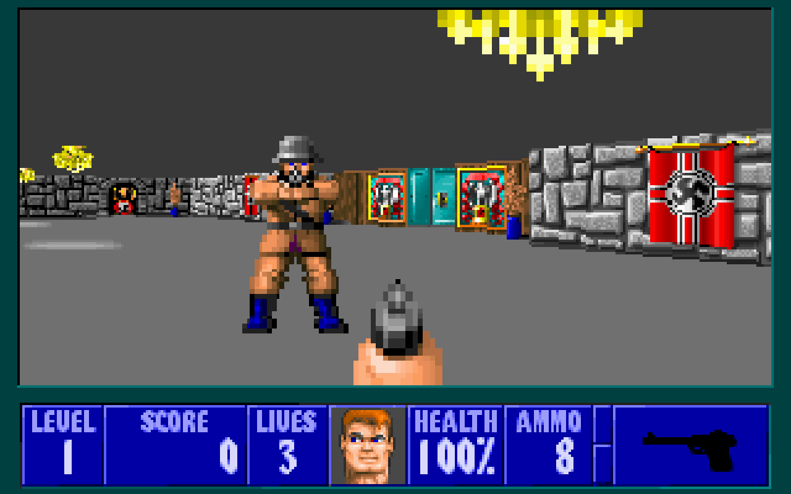
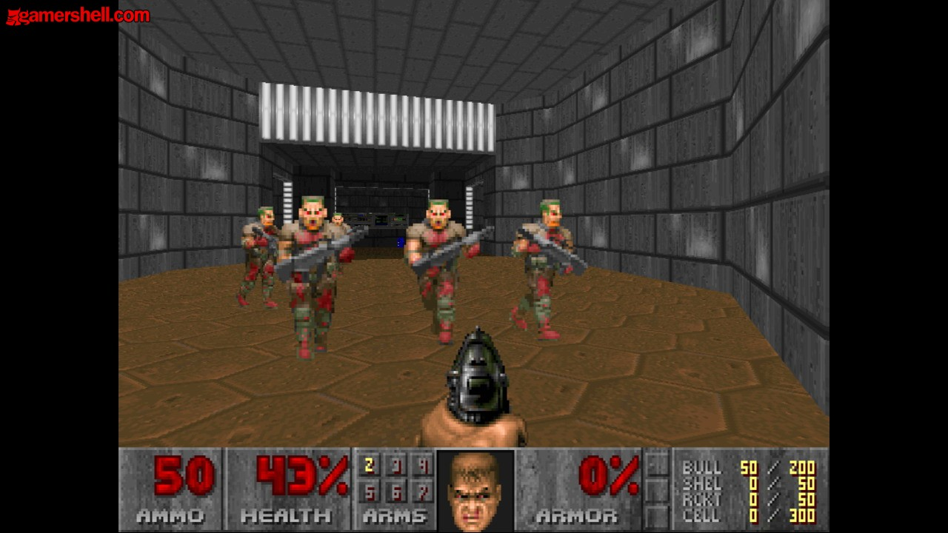
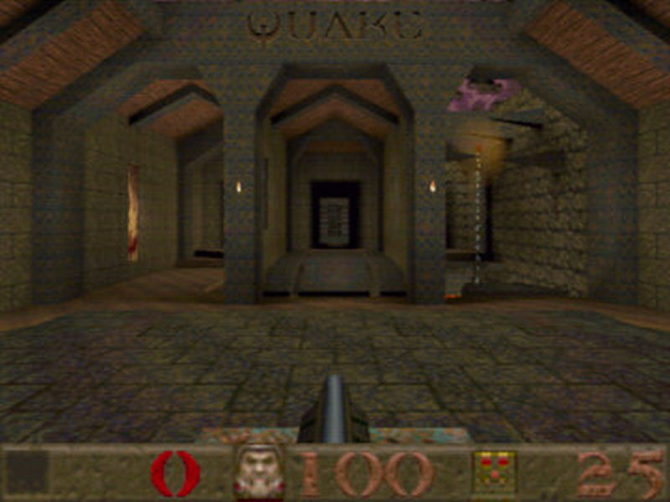

Slide 31
What is a GPU and why do we need it? aka: a brief history of graphics hardware
When consoles came with builtin Graphcis Processing Units there was no going back
GPUs took care of:
Perspective distortion of 3d points (vertices)
Calculating the triangles and filling their pixels
Mapping textures onto the triangles

Slide 32
What is a GPU and why do we need it? aka: a brief history of graphics hardware
Shaders were super simple
You could:
Send a bunch of vertices to the GPU
Tell it to connect vertices to triangles
And maybe slap a texture onto it

Slide 33
How does 3d hardware work (abridged)
Heyo GPU!
CPU
GPU
What?
Look at these points!

Slide 34

How exactly does 3d hardware work
Okay?!
CPU
GPU
Duude they are like waay off screen, can you shift them a bit?
Hokay!

Slide 35

How does 3d hardware work (abridged)
Cool, now I‘m going to give you Numbers…
CPU
GPU
Bring it!

Slide 36
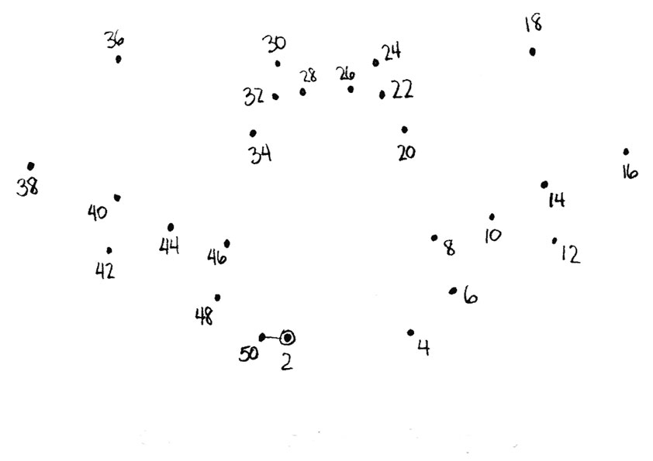
How does 3d hardware work (abridged)
Ok, can you connect them in order?
CPU
GPU
I was MADE FOR THIS!

Slide 37
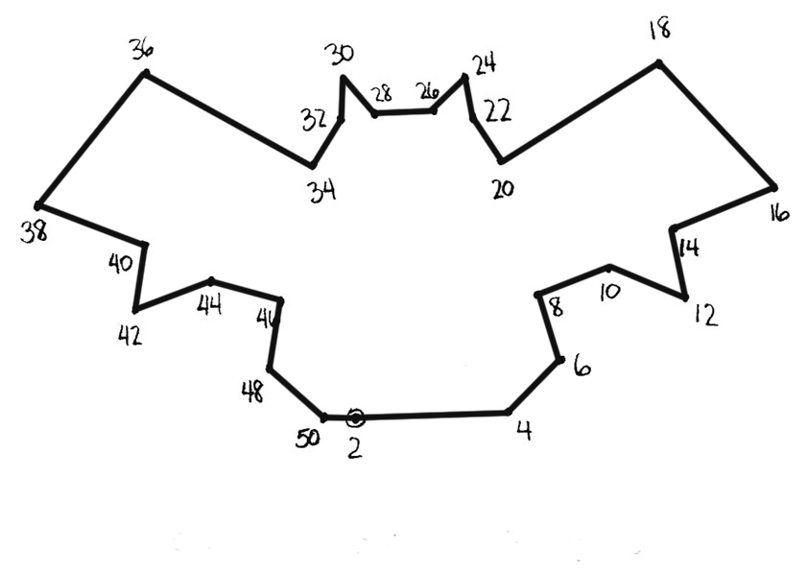
How does 3d hardware work (abridged)
Nice, can you Fill them?
CPU
GPU
Sure thing!
Wait! Can you please use this texture to fill them?

Slide 38
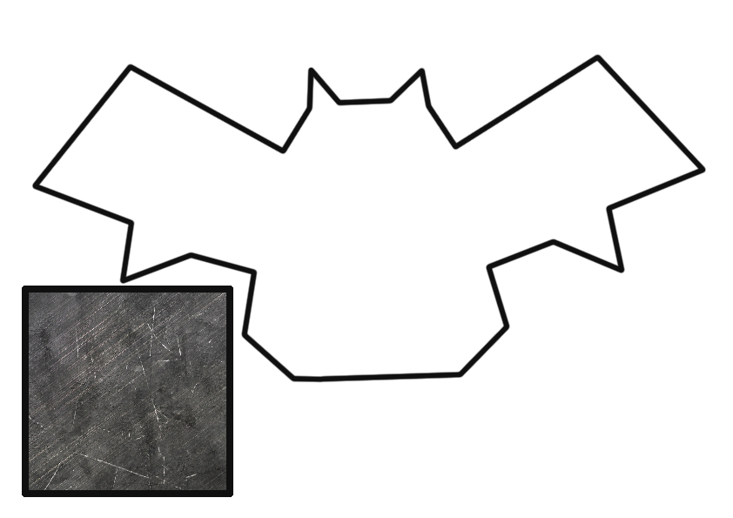
How does 3d hardware work (abridged)
Leave it to me!
CPU
GPU

Slide 39
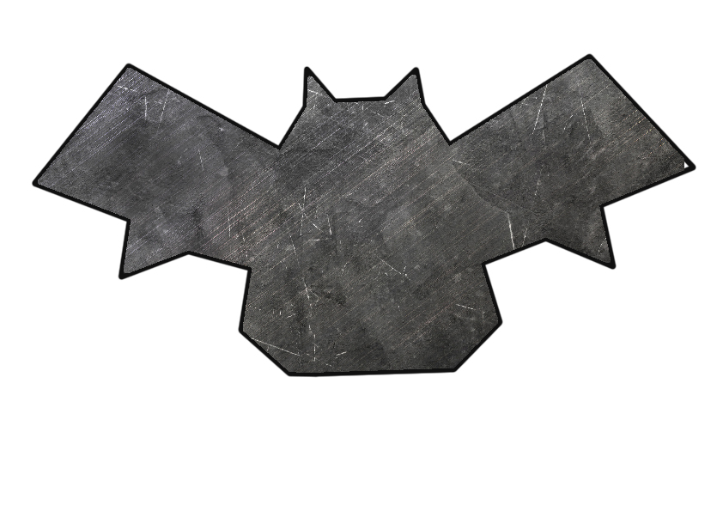
How does does 3d hardware work (abridged)
Done!
CPU
GPU
Nice work! That should be all…
Ok, thxbye!

Slide 40
How does 3d hardware work (abridged)
You could also:
Choose different basic lighting methods
Sometimes fancy predefined effects, like wobbling the texture

Slide 41
How does 3d hardware work (abridged)
People wanted more, for example
Move vertices around separately
Make their own cool unique texture effects
Do procedural effects, with the POWER OF MATH!!!

Slide 42
How does 3d hardware work (abridged)
SHADERS WERE BORN!

Slide 43
How does 3d hardware work (abridged)
Shaders come in two parts:
Vertex shader
Fragment shader

Slide 44
Vertex Shader
Moves the vertices to the correct position on screen
Also does things like:
Vertex displacement
Precalculation of complex math for fragment shader
v2f vert (vertexData v)
{
v2f o;
o.vertex = mul(MVP_MATRIX, v.vertex);
o.uv = v.uv;
return o;
}

Slide 45
Fragment Shader
Converts „Fragments“ to final pixel colors on screen
Calculates colors based on:
Textures
Vertex Colors
Math
Complex Math prepared inside the vertex shader
fixed4 frag (v2f i) : SV_Target
{
fixed4 col = tex2D(_Texture, i.uv);
return col;
}

Slide 46
How exactly does 3d hardware work
Thats it.

Slide 47
Questions?

Slide 48
Assignment!
Find cool effects in games and movies you like or come up with your own
We‘re going to look at how they were done
You have 15 Minutes!
GO!
Notes:
Starcraft Shields

